Slide 1
Make your own PowerPoint Jigsaw Puzzles
Put
Your
Here
Message

Slide 2
With these pieces you can make different sized jigsaws
Text here
Text here
Text here
Text here
Text here
Text here
Text here
Text here
Text here
Text here
Text here

Slide 3
You can colour the pieces and add text and images
Text here
Text here
Text here
Text here
Text here
The
missing
link
Text Here
Text here
Text here
To add an image right click and
Format Picture > Fill > Picture or Texture Fill

Slide 4
Put
Your
Message
Here

Slide 5
You can make a picture jigsaw .. (but it is a bit fiddley) To start remove the "Shape Outline"

Slide 6
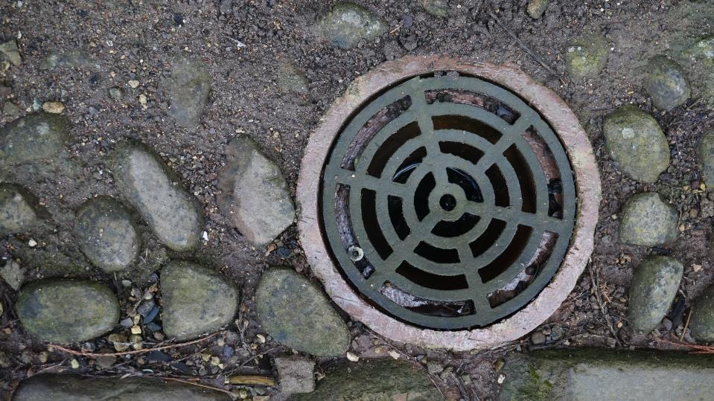
Then lay a photo over the top and select the photo and the pieces

Slide 7
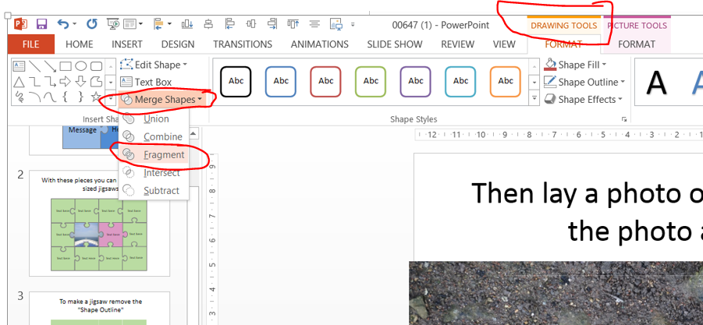
Then Select Drawing Tools > Merge Shape > Fragment

Slide 8
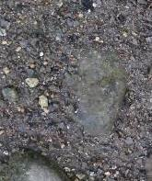
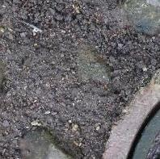
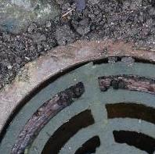
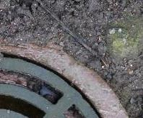
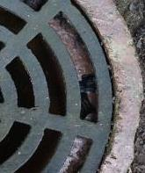
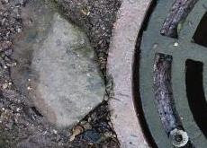
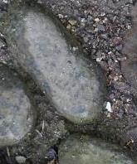
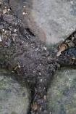
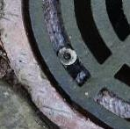
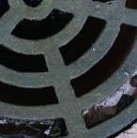
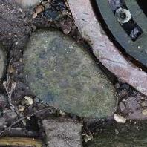
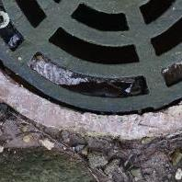
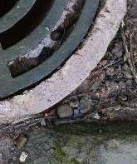
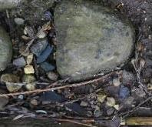
To make a jigsaw remove the "Shape Outline"

Slide 9
Cut and paste the shapes to a new slide and add in some outline

Slide 10
Use of templates
You are free to use these templates for your personal and business presentations.
We have put a lot of work into developing all these templates and retain the copyright in them. You can use them freely providing that you do not redistribute or sell them.
Do
Use these templates for your presentations
Display your presentation on a web site provided that it is not for the purpose of downloading the template.
If you like these templates, we would always appreciate a link back to our website. Many thanks.
Don’t
Resell or distribute these templates
Put these templates on a website for download. This includes uploading them onto file sharing networks like Slideshare, Myspace, Facebook, bit torrent etc
Pass off any of our created content as your own work
You can find many more free PowerPoint templates on the Presentation Magazine website www.presentationmagazine.com

